Slide 1
Difference Between JDK and JRE
KEY | JDK | JRE
DEFINITION | JDK(Java Development Kit) is used to develop Java applications. JDK also contains numerous development tools like compilers, debuggers, etc. | JRE(Java Runtime Environment) is the implementation of JVM(Java Virtual Machine) and it is specially designed to execute Java programs.
FUNCTIONALITY | It is mainly used for the execution of code and its main functionality is development. | It is mainly used for creating an environment for code execution.
DEPENDENCY OF PLATFORM | It is platform-dependent. | It is also platform-dependent like JDK.
TYPE OF TOOLS | Since JDK is responsible for the development purpose, therefore it contains tools which are required for development and debugging purpose. | On the other hand, JRE is not responsible for development purposes, so it doesn’t contain such tools as the compiler, debugger, etc. Instead, it contains class libraries and supporting files required for the purpose of execution of the program.
IMPLEMENTATION OF JDK AND JRE | JDK = JRE + other development tools. | JRE = JVM + other class libraries.

Slide 2
Class Loaders in Java
The Java ClassLoader is a part of the Java Runtime Environment that dynamically loads Java classes(.class files) into the Java Virtual Machine. The Java run time system does not need to know about files and file systems because of classloaders.
Java classes aren’t loaded into memory all at once, but when required by an application. At this point, the Java ClassLoader is called by the JRE and these ClassLoaders load classes into memory dynamically.
Types of Class Loaders in Java
1) BootStrap ClassLoader
2) Extension ClassLoader
3) System/Application ClassLoader

Slide 3
Boot Strap Class Loader
A Bootstrap Classloader is a Machine code which kickstarts the operation when the JVM calls it. It is not a java class.
Bootstrap ClassLoader loads classes from the location rt.jar.
Bootstrap ClassLoader doesn’t have any parent ClassLoaders. It is also called as the Primodial ClassLoader.

Slide 4
Extension Class Loader
The Extension ClassLoader is a child of Bootstrap ClassLoader and loads the extensions of core java classes from the respective JDK Extension library.
It loads files from jre/lib/ext directory or any other directory pointed by the system property java.ext.dirs.

Slide 5
System Class Loader
An Application ClassLoader is also known as a System ClassLoader. It loads the Application type classes found in the environment variable CLASSPATH, -classpath or -cp command line option.
The Application ClassLoader is a child class of Extension ClassLoader.
Note : The ClassLoader Delegation Hierarchy Model always functions in the order Application ClassLoader->Extension ClassLoader->Bootstrap ClassLoader.
The Bootstrap ClassLoader is always given the higher priority, next is Extension ClassLoader and then Application ClassLoader.

Slide 6
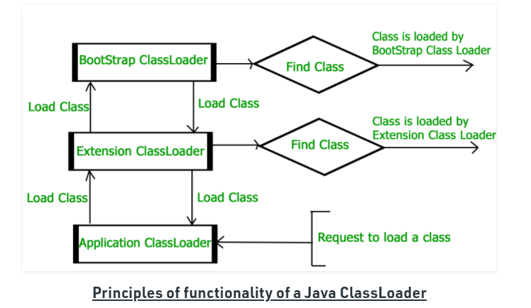

Slide 7
1. Delegation Model
The Java Virtual Machine and the Java ClassLoader use an algorithm called the Delegation Hierarchy Algorithm to Load the classes into the Java file.
The ClassLoader works based on a set of operations given by the delegation model. They are:
ClassLoader always follows the Delegation Hierarchy Principle.
Whenever JVM comes across a class, it checks whether that class is already loaded or not.
If the Class is already loaded in the method area then the JVM proceeds with execution.
If the class is not present in the method area then the JVM asks the Java ClassLoader to load that particular class, then ClassLoader hands over the control to Application ClassLoader.
Application ClassLoader then delegates the request to Extension ClassLoader and the Extension ClassLoader in turn delegates the request to Bootstrap ClassLoader.
Bootstrap ClassLoader will search in the Bootstrap classpath(JDK/JRE/LIB). If the class is available then it is loaded, if not the request is delegated to Extension ClassLoader.
Extension ClassLoader searches for the class in the Extension Classpath(JDK/JRE/LIB/EXT). If the class is available then it is loaded, if not the request is delegated to the Application ClassLoader.
Application ClassLoader searches for the class in the Application Classpath. If the class is available then it is loaded, if not then a ClassNotFoundException exception is generated.

Slide 8
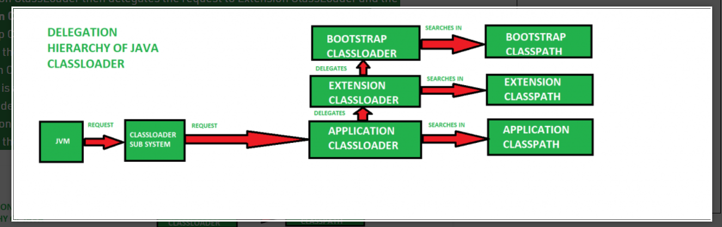

Slide 9
2. Visibility Principle
The Visibility Principle states that a class loaded by a parent ClassLoader is visible to the child ClassLoaders but a class loaded by a child ClassLoader is not visible to the parent ClassLoaders.
Suppose a class GEEKS.class has been loaded by the Extension ClassLoader, then that class is only visible to the Extension ClassLoader and Application ClassLoader but not to the Bootstrap ClassLoader.
If that class is again tried to load using Bootstrap ClassLoader it gives an exception java.lang.ClassNotFoundException.

Slide 10
3. Uniqueness Property
The Uniquesness Property ensures that the classes are unique and there is no repetition of classes. This also ensures that the classes loaded by parent classloaders are not loaded by the child classloaders.
If the parent class loader isn’t able to find the class, only then the current instance would attempt to do so itself.
Methods of Java.lang.ClassLoader
After the JVM requests for the class, a few steps are to be followed in order to load a class. The Classes are loaded as per the delegation model but there are a few important Methods or Functions that play a vital role in loading a Class.
loadClass(String name, boolean resolve): This method is used to load the classes which are referenced by the JVM. It takes the name of the class as a parameter. This is of type loadClass(String, boolean).
defineClass(): The defineClass() method is a final method and cannot be overriden. This method is used to define a array of bytes as an instance of class. If the class is invalid then it throws ClassFormatError.

Slide 11
3. findLoadedClass(String name): This method is used to verify whether the Class referenced by the JVM was previously loaded or not.
4. Class.forName(String name, boolean initialize, ClassLoader loader): This method is used to load the class as well as initialize the class. This method also gives the option to choose any one of the ClassLoaders. If the ClassLoader parameter is NULL then Bootstrap ClassLoader is used.
5. findClass(String name): This method is used to find a specified class. This method only finds but doesn’t load the class.

